Slide 1
Achieving secure, universal, and fine-grained query results verification for secure search scheme over encrypted cloud data

Slide 2
ABSTRACT
we design a secure, easily integrated, and fine-grained query results verification mechanism, by which, given an encrypted query results set, the query user not only can verify the correctness of each data file in the set but also can further check how many or which qualified data files are not returned if the set is incomplete before decryption.
The verification scheme is loose-coupling to concrete secure search techniques and can be very easily integrated into any secure query scheme.

Slide 3
We achieve the goal by constructing secure verification object for encrypted cloud data.
Furthermore, a short signature technique with extremely small storage cost is proposed to guarantee the authenticity of verification object and a verification object request technique is presented to allow the query user to securely obtain the desired verification object.
Performance evaluation shows that the proposed schemes are practical and efficient.

Slide 4
EXISTING SYSTEM
Some approaches have been proposed based on traditional searchable encryption schemes, which aim to protect data security and query privacies with better query efficient for cloud computing.
However, all of these schemes are based on an ideal assumption that the cloud server is an ”honest-but-curious” entity and keeps robust and secure software/hardware environments.

Slide 5
As a result, correct and complete query results always are unexceptionally returned from the cloud server when a query ends every time.
However, in practical applications, the cloud server may return erroneous or incomplete query results once he behaves dishonestly for illegal profits such as saving computation and communication cost or due to possible software/hardware failure of the server.

Slide 6
Disadvantages of Existing System
The verification mechanisms provide a coarse-grained verification, i.e., if the query result set contains all qualified and correct data files, then these schemes reply yes, otherwise reply no.
Thus, if the verification algorithm outputs no, a data user has to abort the decryption for all query results despite only one query result is incorrect.
The verification mechanisms are generally tightly coupled to corresponding secure query constructions and have not universality

Slide 7
PROPOSED SYSTEM
We formally propose the verifiable secure search system model and threat model and design a fine-grained query results verification scheme for secure keyword search over encrypted cloud data.
We propose a short signature technique based on certificateless public-key cryptography to guarantee the authenticity of the verification objects themselves.

Slide 8
We design a novel verification object request technique based on Paillier Encryption, where the cloud server knows nothing about what the data user is requesting for and which verification objects are returned to the user.

Slide 9
Advantages of Proposed System
Our scheme can verify the correctness of each encrypted query result or further accurately find out how many or which qualified data files are returned by the dishonest cloud server

Slide 10
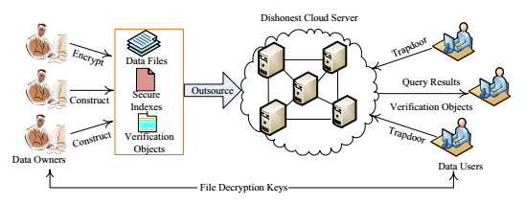
System Architecture

Slide 11
Module
Data Owner Module
Data User Module
Cloud Server Module

Slide 12
Module Description:
Data Owner:
Data owners encrypt their private data and upload them to cloud server for enjoying the abundant benefits brought by the cloud computing as well as guaranteeing data security. Meanwhile, the secure searchable indexes are also constructed to support effective keyword search over encrypted outsourced data.

Slide 13
Data User:
An authorized data user obtains interested data files from the cloud server by submitting query trapdoors (encrypted query keywords) to the cloud server.
Cloud Server:
Cloud server can performs search over secure indexes according to trapdoors and sends the query results to the data user

Slide 14
SYSTEM REQUIREMENTS
Hardware Requirements
Processor - Pentium –IV
Speed - 1.1 GHz
Ram - 256 MB
Hard Disk - 20 GB
Key Board - Standard Windows Keyboard
Mouse - Two or Three Button Mouse
Monitor - SVGA

Slide 15
Software Requirements
Operating System - Windows XP
Coding Language - Java

Slide 16
Thank you

